Slide 1
Infant Feeding
Archie Kerr
4.10.2023
Notes:
For 13 million years evolving humans learned with their animal peers that the normal, indeed the only, way for their offspring to thrive was for them to be breast fed with the appropriate mammalian milk as supplied. Keep the supply going for 2 to 7 years, keep them warm and dry, prevent marauding animals and other humans feasting on them, teach them how to survive generally and, Bob’s your uncle, you’ve passed on your genes to the next generation.
It wasn’t until sometime later that someone came up with the idea that those groups and individuals who managed this project best would last the distance while those who didn’t faded from view.

Slide 2
A Neolithic Hittite Gold Statuette in the Ankara Museum of Antiquities
Notes:
In general the idea caught on and we see numerous references to breast feeding in the literature of the day eg. This gold statue in the Anchara Museum of Ancient Civilisation.
It is unarguably accepted that breast feeding is the most appropriate method of feeding human babies – except that I discovered once that it isn’t. I was involved some years ago with a mother who said that her milk was no good for her baby. Not quite believing her, I got a sample and sure enough, it had no fat in it and looked just like thin egg white. She had this genetic abnormality as did her own mother. I’m not aware of this as a common problem so the adage that “breast is best” seems a reasonably secure axiom.

Slide 3
Lactation Failure Papyrus Ebers, 1550 BCE, Egypt
To get a supply of milk in a woman's breast for suckling a child: Warm the bones of a sword fish in oil and rub her back with it. Or: Let the woman sit cross-legged and eat fragrant bread of soused durra, while rubbing the parts with the poppy plant. (Wickes, 1953a, p. 154)
Notes:
Breastfeeding was not always possible, however, due to lactation failure of the mother (Wickes, 1953a) or to the mother dying from childbirth (Fildes, 1986). Lactation failure is mentioned in the earliest medical encyclopedia, The Papyrus Ebers, which came from Egypt (1550 BC) and contains a small pediatric section that includes a prescription for lactation failure, as follows:

Slide 4
Wet Nursing
As early as 2000 BCE
In 950 BCE Greece, wet nurses had high status and managed the slaves
In the Roman Empire (300BCE to 400CE) wet nurses, under contract fed (female) babies, abandoned on the rubbish → cheap slaves
Later in Europe some young women got rid of their own baby to earn a living as a wet nurse
In France they were registered, had a medical examination and had to feed their own baby for 9 months.
Notes:
The approach of mothers feeding their babies at the breast generally was the accepted method until man, and I use the term advisedly, decided to improve his station, bid for power and show off how civilised and important he was.
This led to two innovations:
Hiring someone else to feed your baby as you couldn’t possibly have your wife baring her boobs in private, much less in public. Anyway why should either you or your wife interrupt the important social and business events of life for worthless babies- half of whom died anyway.
The second innovation was to try and find an alternative milk to use which wouldn’t result in a sickly or even dead infant.
Wet nursing is recorded as early as 2000 BC and extended until the 20th century. Throughout this time period, wet nursing evolved from a requirement of need (2000 BC) to an alternative of choice (950 BC to 1800 AD). It became a well-organized profession with contracts and laws designed to regulate its practice. Despite objections during the Middle Ages and the Renaissance, wet nursing continued until the feeding bottle was introduced in the 19th century. With a feasible alternative feeding method available, wet nursing as a profession quickly declined to extinction.
In Greece circa 950 BC, women of higher social status frequently demanded wet nurses. Eventually, wet nurses acquired a position of great accountability and had authority over slaves (Wickes,)
At the height of the Roman Empire, between 300 BC and 400 AD, written contracts were formed with wet nurses to feed abandoned infants. The infants were usually unwanted females thrown onto rubbish piles. The wealthy purchased the infant as an inexpensive slave for future use, and the wet nurses—who were slaves themselves—fed the infant for up to 3 years. Contracts provided a detailed account of the wet nursing service, including duration of breastfeeding, clothing supplies, lamp oil, and payment for the service (Anonymous, 1987).
A common practice among young, unmarried or married women was to have a child and then get rid of it prior to seeking employment as a wet nurse (Osborn, 1979b). As a result, in France, wet nurses were registered at a municipal employment bureau, and laws were developed and enforced to regulate their employment. The laws required a wet nurse to undergo a medical examination and forbade her to breastfeed another child until her own infant was 9 months old (Osborn, 1979b).

Slide 5
“The Fashionable Mamma or the Convenience of Modern Dress” Coloured etching by James Gillray, published in 1796
Notes:
During the same time period, societal class tended to dictate breastfeeding practices. It was unusual for aristocratic women to breastfeed because the practice was considered unfashionable and because the women worried it would ruin their figures (Wickes, 1953b). Breastfeeding also prevented many women from wearing the socially acceptable clothing of the time (Fildes, 1986), and it interfered with social activities such as playing cards and attending theatre performances (Wickes, 1953b). The wives of merchants, lawyers, and doctors also did not breastfeed because it was less expensive to employ a wet nurse than it was to hire a woman to run their husband's business or take care of the household in their place (Fildes, 1986).
It goes without saying that wet nurses provided an appropriate milk for humans, but it could be at the expense of another infant, namely the mother’s own child as she was having to be a wet nurse to make enough money to survive. This was not always the case and some did it professionally as it were.

Slide 6
“The Nursing of Children” Jaques Guillemeau, early 17th Cent
Objections:
The child may be switched and another put in its place
The affection felt between the child and its mother will diminish
A bad condition may be inherited by the child
The nurse may transmit an imperfection of her own body to the child that could be transmitted to the parents
Notes:
In the early 17th century, the French obstetrician Jacques Guillemeau supported the premise that the natural mother should nurse her child (Wickes, 1953b). His work, The Nursing of Children, included an eight-page preface addressing this advice. Guillemeau stated four main objections to a wet nurse: 1) the child may be switched with another put in its place, 2) the affection felt between the child and the mother will diminish, 3) a bad condition may be inherited by the child, and 4) the nurse may transmit an imperfection of her own body to the child that could then be transmitted to the parents.

Slide 7
Carl Linnaeus (1707 – 1778)
… was perceptive enough to say that wet-nursing was a bad idea as there was much more involved with breast feeding than just the calories. The emotional attachment developed between mother and child was equally important.
Notes:
It is noteworthy that Carl Linnaeus (1707 – 1778) when he was busy reminding humans that they were animals too, but just with a different taxonomic label. When I’m having a bad day sometimes, I think he might have overstated our label when he specified us as Homo sapiens. Anyway, he was perceptive enough to say that wet-nursing was a bad idea as there was much more involved with breast feeding than just the calories. The emotional attachment developed between mother and child was equally important.
By the end of the 18th century in Europe, four modes of feeding were in use: maternal breastfeeding, wet nursing, hand feeding with animal milks, and with pap and/or panada (soft mushy mixtures of bread or flour with milk or water or egg, some cooked in broth) [16]

Slide 8
Soranus’ and Galen’s dietary prescriptions for infants
Soranus Galen
(circa 70-130 AD) (circa 130-200 AD)
First food Honey + cow’s milk Honey
Start of breastfeeding Wetnurse on 2nd day, mother on 20th day
Breastfeeder (mother or wetnurse) Mother, wetnurse (only if necessary) Mother
Technique Don’t give colostrum
Quantity Frequently
Introduction of foods After 40th day; preferably after 6 months After first tooth
Complementary foods Cereal, bread + milk or wine, porridge, eggs; not pre-chewed Bread, vegetables, meat, milk
Wine Diluted Contraindicated
Weaning 18-24 months, gradual 3 years
Notes:
Soranus of Ephesus (98 AD to 117 AD) composed an obstetrical and gynecological treatise of 23 chapters that included a model for infant feeding (Osborn, 1979a). The treatise included the choice of and regimen for a wet nurse. It also described the fingernail test used for assessing the quality and consistency of breastmilk. When a drop of breastmilk was placed on a fingernail and the finger moved, the milk was not supposed to be so watery that it ran all over the surface of the nail. When the fingernail was turned downward, the milk was not to be thick enough to cling to the nail. The consistency of the milk should range between the two extremes. Soranus’ criterion was used for the next 1,500 years to determine breastmilk quality (Wickes, 1953a).
Soranus also wrongly saw colostrum as indigestible

Slide 9
Prehistoric family scene showing infant being fed with baby bottle similar to those we sampled. Christian Bisig / Archäologie der Schweiz
Notes:
Clearly people had used animal milk as an alternative for a long time as this ‘photographic’ evidence shows.

Slide 10
Selection of Late Bronze Age feeding vessels. Vessels are from Vienna, Oberleis, Vösendorf and Franzhausen-Kokoron (from left to right), dated to around 1200 to 800 BC. Katharina Rebay-Salisbury
Notes:
Recently, from children’s graves in Bavaria, archaeologists have found traces of animal milk in pottery from 450 to 1200 BCE. A variety of prehistoric pots have been identified with teat-shaped spouts and even shaped like an animal that seem to have been used for feeding young infants - or some cases possibly, the elderly!
Many different devices were used to feed animal's milk to infants. Some of the devices found were made from wood, ceramics, and cows' horns. In fact, a perforated cow's horn was the most common type of feeding bottle during the Middle Ages. By the 1700s, many infant-feeding devices were made from pewter and silver (Weinberg, 1993).
The end of the spout formed a knob in the shape of a small heart, with three to four small holes punched into it. A small rag was tied over the holes for the infant to play with and suck milk through (Wickes, 1953d). During the same era, rags, small pieces of linen cloth, and sponges were often used as a teat or nipple (Weinberg, 1993).

Slide 11
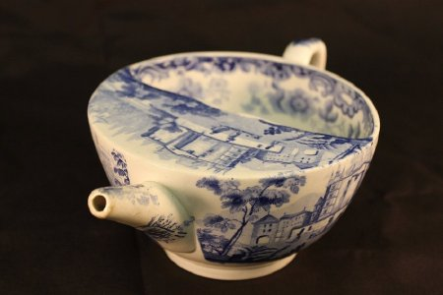
Pap Feeders
Notes:
Another feeding device used from the 16th to 18th centuries in Europe was a pap boat. The device was used to feed infants pap and panada. Pap consisted of bread soaked in water or milk (Radbill, 1981), and panada consisted of cereals cooked in broth (Wickes, 1953b). Both substances were used as a supplement to animal's milk, especially when the infant showed a failure to thrive. The pap boat included a spoon with a hollow stem so that the pap or panada could be blown down the infant's throat. Compared to breastfeeding, the use of the pap boat enabled the infant to receive food quickly and in much larger quantity during feeding (Weinberg, 1993).
Unfortunately, feeding bottles, pap boats, and teats during the 16th to18th centuries were difficult to clean. Subsequently, the build-up of bacteria made the feeding devices detrimental to the infant's health. In the early 19th century, the use of dirty feeding devices, combined with the lack of proper milk storage and sterilization, led to the death of one third of all artificially fed infants during their first year of life (Weinberg, 1993).

Slide 12
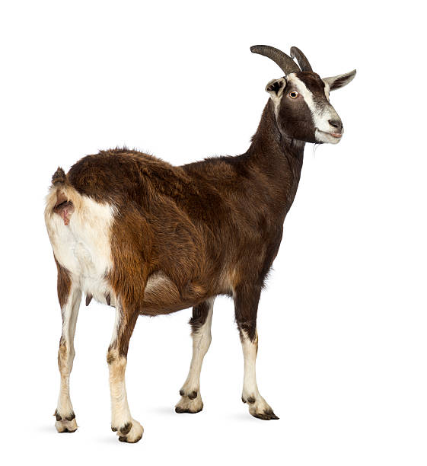
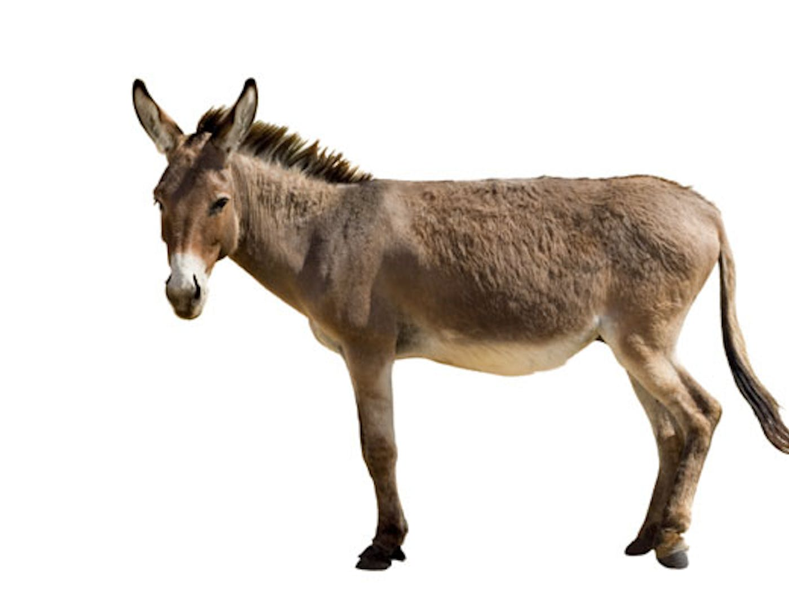
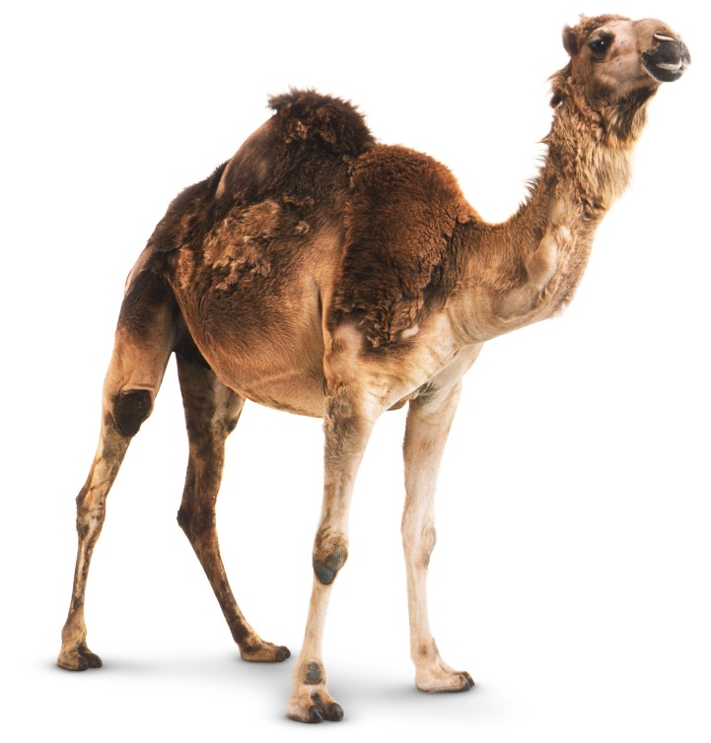
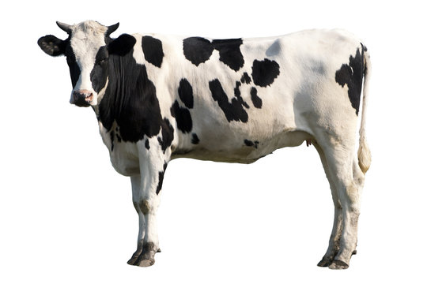
Other Options
Notes:
Other mammals, presumably the ones in your flocks: sheep, goats, horses, camels.
All of these various animals have been used up until current times. Eg, a recent study on infants fed on camel milk in the Horn of Africa showed that they did much better than those who did not have access to it. I’m not sure how much compounding factors were taken into account - I assume you’d have to be relatively well-off to have access to a camel. I think, in fact they looked at separate population groups who did or did not have camels.

Slide 13
Notes:
An early option from the origins of Classical Rome was Romulus and Remus being fed by a wolf. Suitably heroic and good for your image, but you don’t have to believe everything you hear!
On the other hand…..

Slide 14
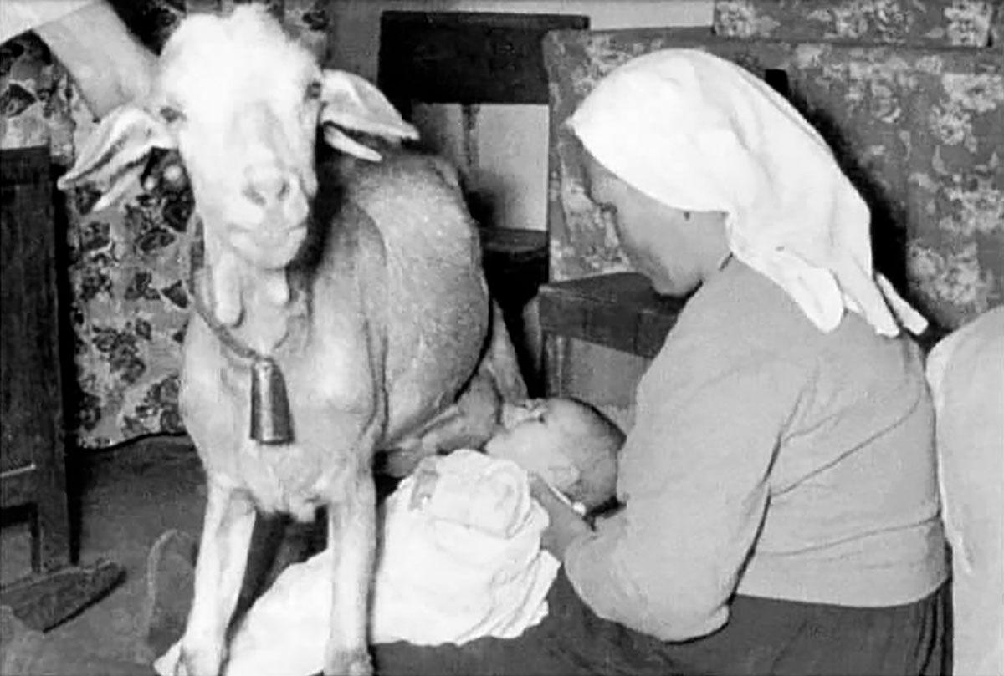
Nanny Goats
Notes:
Rather than milk your goat and pass the milk on to your baby, people developed ways of bypassing the middleman. I understand a well-trained goat would come into the nursery, park itself over the baby’s crib and offer a teat without a second thought. It sounds a bit like a completely automated milking system on a farm in Ireland where cows would toddle off to the milking shed when they wanted to, and AI would do the rest. I believe goats involved in this activity was the origin of the term: ‘nanny goat’.

Slide 15
Donkeys nurse babies at a French hospital for sick infants. (Wellcome Library, London)
Notes:
In some orphanages where there weren’t enough goats, ponies could be used as alternatives

Slide 16
Wild Peter, from Hanover was found in 1725. George I England ordered the boy to be brought to England where he was basically put on show as a ‘pet' at the court Ultimately he lodged at farms with a State Pension and died about 70 years old. Originally thought to have become so hairy because he had been fed by a bear. In 1978, a recently identified chromosomal disorder, Pitt-Hopkins Syndrome, was thought to be responsible for his condition.
Notes:
A word of warning: in Germany, in 1724 a very hairy young man, Wild Peter, became famous and his hirsute appearance was said to be because he had been fed by a bear and the prevailing understanding was that such babies took on the characteristics of the animal feeding them. This unfortunate young man was taken off to England by George I and used as a curiosity for public display until they got tired of it. He is actually suspected to be the chromosomal disorder Pitt–Hopkins syndrome, a condition identified only in 1978, nearly 200 years after Peter's death. Various physical attributes of Peter's which are evident in the Kensington Palace portrait have been matched to the condition, such as his curvy "Cupid's bow" lips, his short stature, his coarse, curly hair, drooping eyelids and thick lips - of which I have never heard.

Slide 17
The Republic Nourishes and Instructs her Children, Honore Daumier, 1848
Notes:
Politics also comes into the story of breast feeding. There’s a famous picture of the symbol of the French State honouring the Second Republic feeding two hefty toddlers! Was Daumier’s tongue firmly in his cheek?

Slide 18
A woman breast feeding two puppies while two Mexican peasants implore her to feed her baby.
Notes:
We have talked about human babies being fed by animals, but the opposite saw a fashion as well.
Other fashions - one idea was to firm up your nipples prior to childbirth so that you were ready for the onslaught of the newborn.

Slide 19
Infant Formula Development
1760 - Jean Charles Des-Essartz, chemical analysis justified human milk as best
1865 – Justus von Liebig, patented an infant formula of cow’s milk, malt flour & potassium bicarbonate
1810 – Nicholas Appert, sterilised food in sealed containers
1835 – William Newton patented evaporated milk
1853 – Gale Borden, added sugar as Eagle Brand Condensed Milk
1885 – John B Myerling. Developed unsweeetened condensed milk.
Recommended by pediatricians from 1930s to 1940s
Notes:
Initially animal milks were used unchanged, but there must have been some awareness that they were not absolutely appropriate for human babies. Some would be too rich with high fat content, some might seem too watery, whatever. Somewhere along the line people started making up mixtures, often with an animal milk base and adapting that. One of the first recorded was a Roman recipe: if no wet nurse were available, a mixture of Goat’s milk diluted with water and honey added
Dry nursing in 17th and 18th century ?mixture used. In 1688 it was mandated for the infant Prince of Wales, until after 7 weeks of starvation he was rescued by a wet nurse.
In the 18th century, the first chemical analyses of human milk and animal's milk began to appear. Jean Charles Des-Essartz published his Treatise of Physical Upbringing of Children in 1760, which discussed and compared the composition of human milk to that of the cow, sheep, ass, mare, and goat. Based on chemical characteristics, Des-Essartz justified human milk as the best source of infant nutrition. With mother's milk as the ideal, many scientists tried to formulate nonhuman milk to resemble human milk (Radbill, 1981). In 1865, chemist Justus von Liebig developed, patented, and marketed an infant food, first in a liquid form and then in a powdered form for better preservation. Liebig's formula—consisting of cow's milk, wheat and malt flour, and potassium bicarbonate—was considered the perfect infant food (Radbill, 1981).

Slide 20
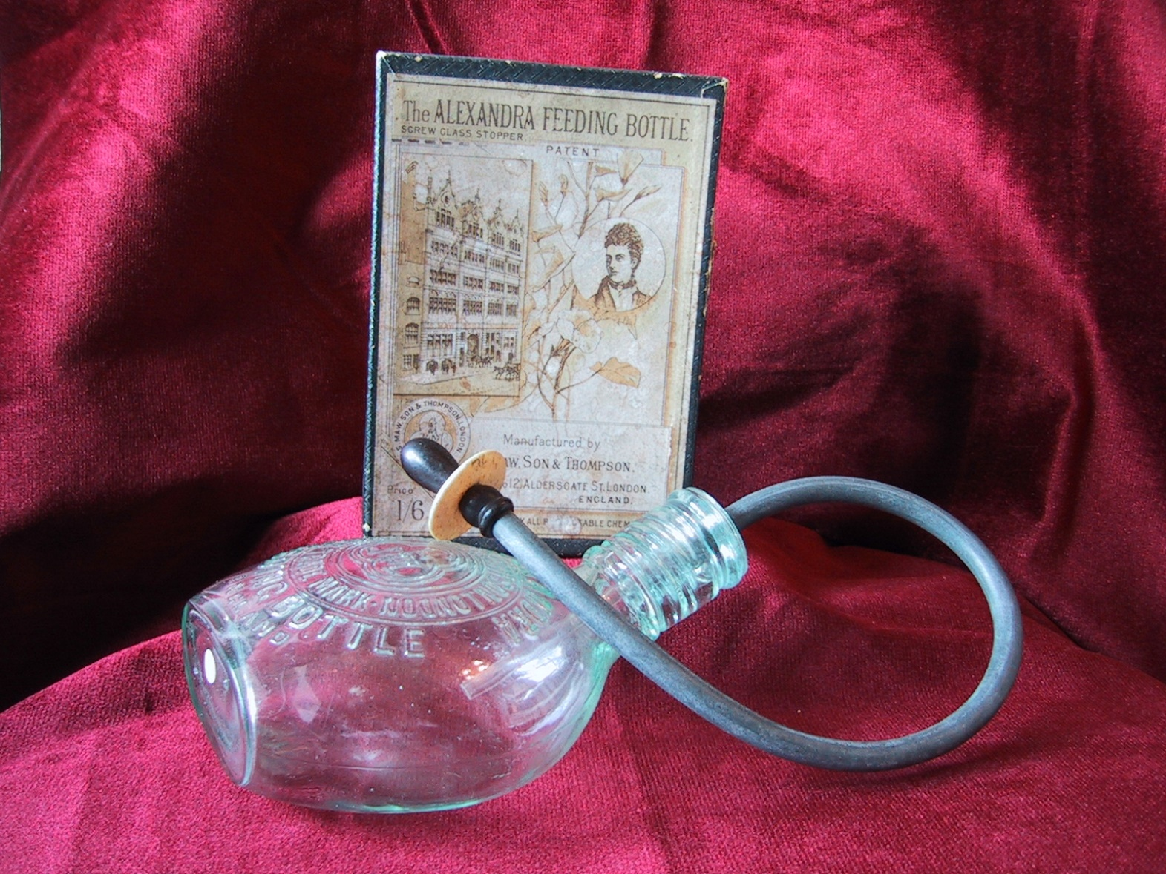
Murder Bottle
Notes:
One of the least satisfactory designs of milk bottle - too difficult to clean properly.

Slide 21
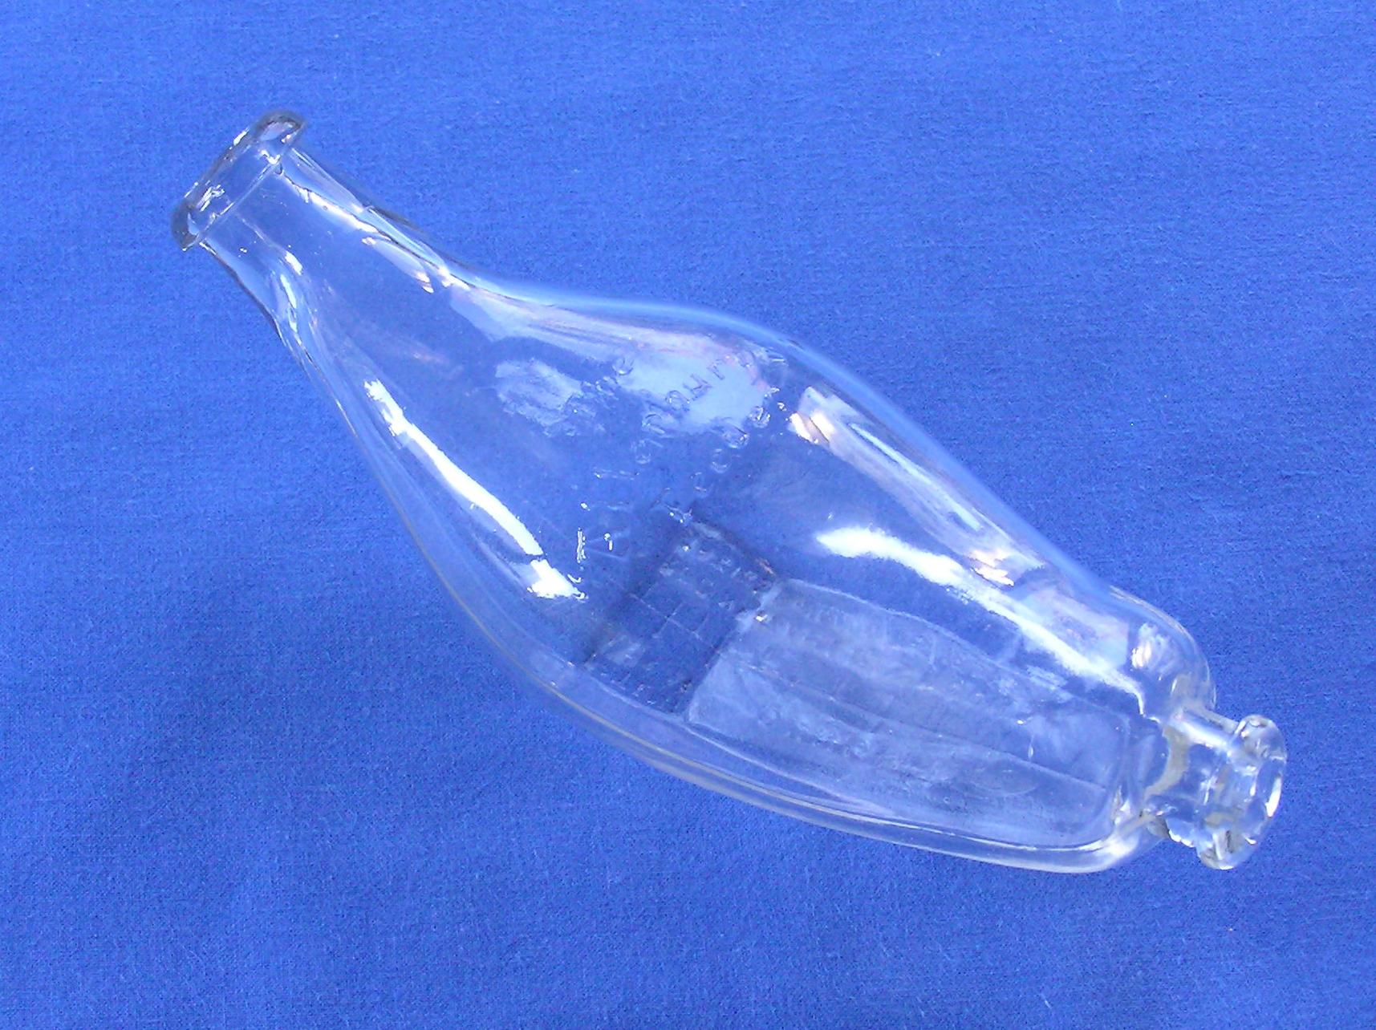
Notes:
Various types of bottle were developed, none were sterilised, some were washed! One was known as The Killer or The Murderer but very popular in spite of condemnation from most doctors. Stevens et al: In the early 19th century, 1/3 of all artificially fed infants died in the first year because of dirty bottles, poor milk storage, etc.
Later the banana model was developed that was easier to wash with an opening at both ends. Teats were difficult until India rubber came along in 1845

Slide 22
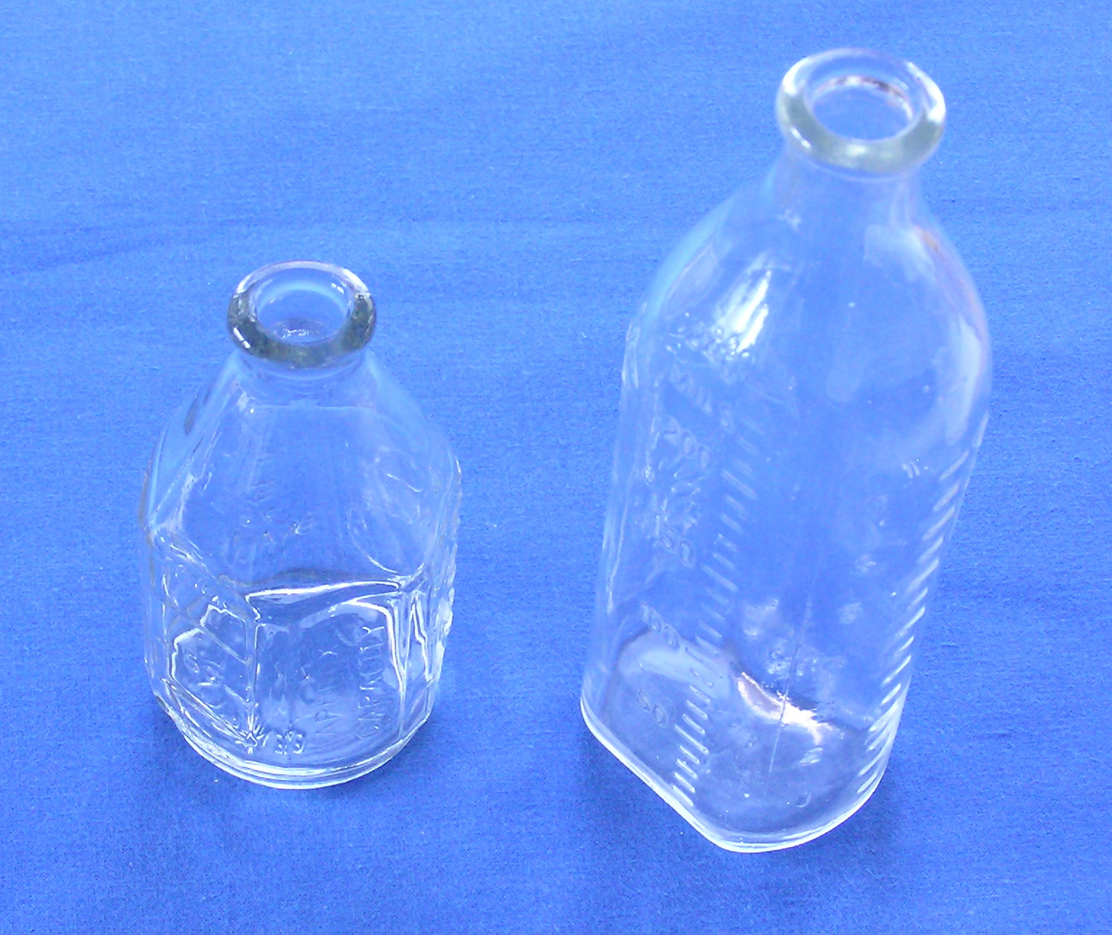
Notes:
Pyrex glass had been developed and bottles became available in 1922 that could be boiled and properly sterilised.

Slide 23
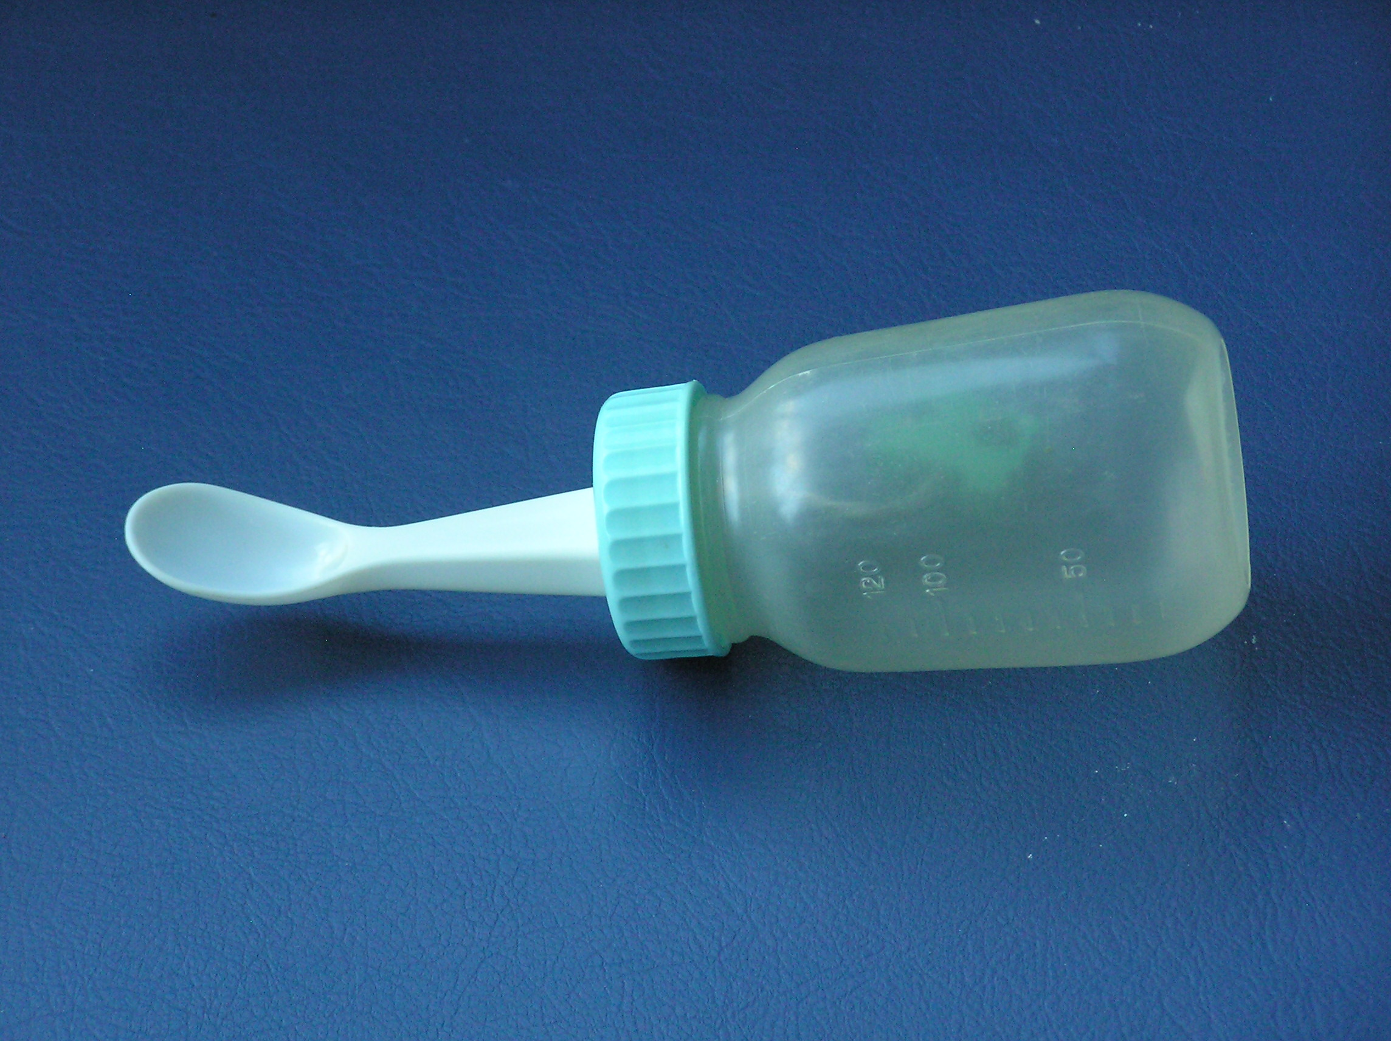
Notes:
Subsequently of course plastic took over with modern array of different bottles that could provide a different one each day for a lifetime - which seems a bit pointless unless perhaps if we need one again in our old age.

Slide 24
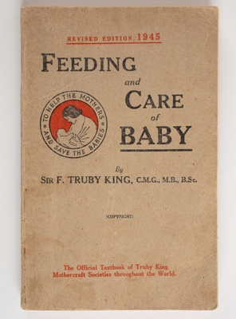
Recipe recommended by Dr Truby King for the Plunket Society in the1920’s (up to the 1970s). Cow’s milk, diluted two to one with water Sugar as lactose (Karilac supplied by the Plunket Society).
Notes:
Truby King devised the Plunket recipe that many of us were raised on.

Slide 25
'Regularity of all Habits', 'clock-work regularity of feeding', 'regularity of bathing and sleeping', and mothers must not allow '10 o'clock in the morning [to] pass without getting baby's bowels to move. . . .‘ The rhythms of the clock defined scientific regularity. If the child cried at any unspecified time it had to be ignored. The baby had to eat, excrete, sleep, and be washed according to the clock.
Notes:
The onerous duties of motherhood increased with the baby's birth. King and Plunket demanded 'Regularity of all Habits', 'clock-work regularity of feeding', 'regularity of bathing and sleeping', and mothers must not allow '10 o'clock in the morning [to] pass without getting baby's bowels to move. . . .'48 The rhythms of the clock defined scientific regularity. If the child cried at any unspecified time it had to be ignored. The baby had to eat, excrete, sleep, and be washing according to the clock. The weight and length of the baby, which the mother had to measure weekly (often under the alert eye of the Plunket nurse), indicated how faithfully the Society's disciplines had been observed. It goes without saying, of course, that babies had to be breast fed or else the 'child suffers a more or less serious wrong'. 'The normal woman is designed for the complete nursing of twins', King maintained.4 ' Toilet training had to be commenced within the first six weeks. Babies had to be fed once every four hours during the day and ignored at night. 'A baby cannot be expected to thrive if its mother is not regular and punctual in the matter of bathing, feeding, and putting her infant to rest. . . .' And the baby thrived only because it had learned to be obedient to the mother, the Society, the dictates of science and the imperatives of time as defined in a capitalist society. Erik Olsen

Slide 26
Truby King’s analysis of the Infant Mortality
Notes:
The basic brew, however is familiar in that it was the recipe recommended by Dr Truby King for the Plunket Society in the1920’s. In fact, in the 1970’s, the standard infant formula was still cow’s milk, diluted two to one with water and with sugar added in the form of lactose (Karilac supplied by the Plunket Society). It was not until the early 1980’s that commercially available formulae started to be used and became almost universal over the 1990’s. A Kerr

Slide 27
Jim Watt, 1961 (Practical Paediatrics: A Guide for Nurses)
Feeding - test-weighing check for whole day. A single feed not much use as amount varies each feed. Artificial - room for options and not dogmatic:
Give balanced mixture - small changes unimportant
Ensure enough - ignore over-feeding bogy
Makes sure infant gets it without effort
Fluid 2 1/2 oz per pound of baby
0 - 10 days: milk: water = 50:50
Up to 4 mths: milk:water = 2:1
add Karilac or cane sugar 1 teaspoon per pound of baby After 4 mths, full strength milk and no sugar
Solids - recommends at 15 lb, but earlier or later depending on mother's wishes. No need for insisting on 15lb. Add vit C and D and iron
Notes:
Jim Watt’s practical advice in 1961.

Slide 28
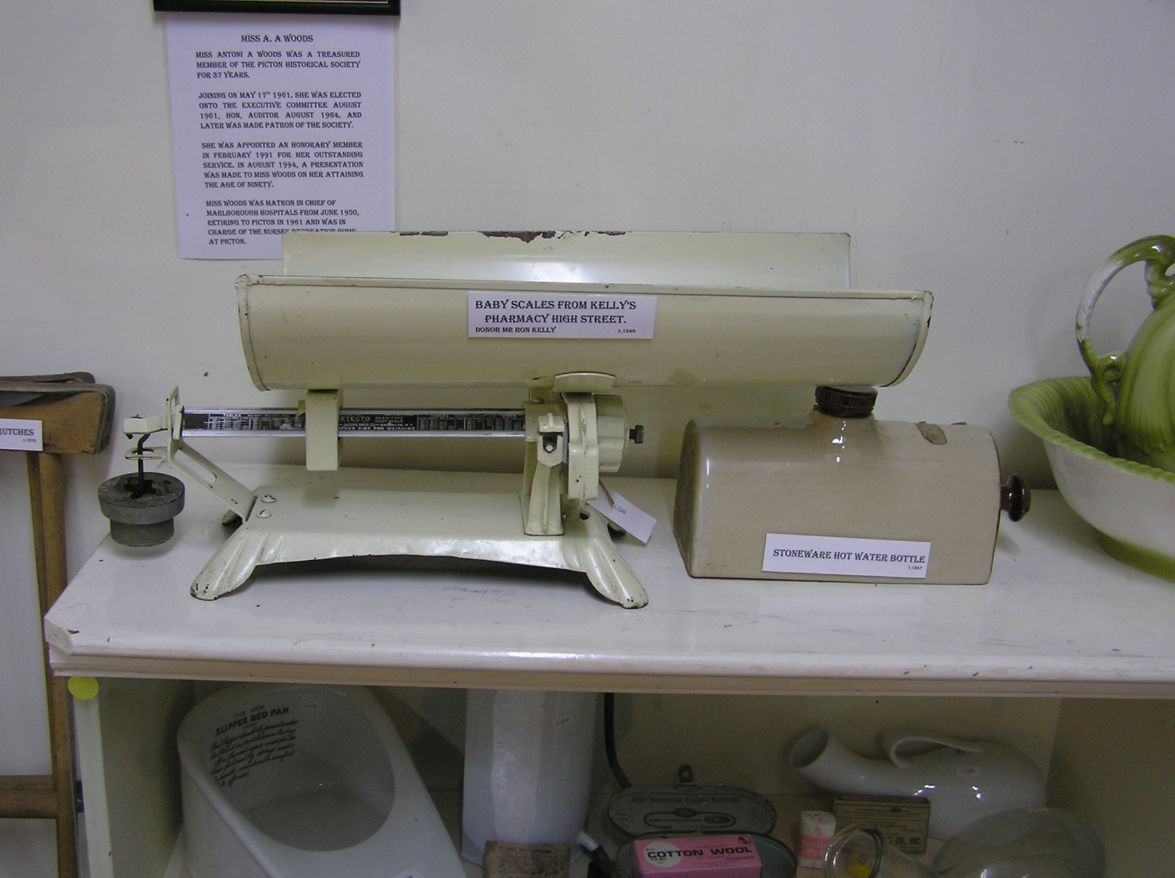
How to improve Breast feeding
Notes:
My thoughts on test weighing: the metrification of weights and measures in the 1970s was one of the big advances for breast feeding that occurred in my time. Why? You may ask. The bar scales we used for test weighing had previously been marked in ounces. With metrification, the same bar and scales were used but the scale on the bar was simply changed to decagrams – roughly the equivalent of a third of an ounce. Such was the confusion that resulted from an unheard of weight that eventually test weighing was stopped and mums were left to get on with feeding their babies without being put off by spurious ‘science’.

Slide 29
Modern Infant Formulas
Attempts to make a composition the same as human milk
Purified cow's milk whey and casein as the protein source
A blend of vegetable oils as the fat source
Lactose as the carbohydrate source
A vitamin-mineral mix
Some contain human milk oligosaccharides for immune development and a healthy gut microbiota
Specialised formulae eg. soy based, protein hydrolysates, lactose free, etc
Notes:
Modern infant formulas - as per slide
Manufacturers state that the composition of infant formula is designed to be roughly based on a human mother's milk at approximately one to three months postpartum; however, there are significant differences in the nutrient content of these products. The most commonly used infant formulas contain purified cow's milk whey and casein as a protein source, a blend of vegetable oils as a fat source, lactose as a carbohydrate source, a vitamin-mineral mix, and other ingredients depending on the manufacturer.^{[3]} Modern infant formulas also contain human milk oligosaccharides, which are beneficial for immune development and a healthy gut microbiota in babies. In addition, there are infant formulas using soybean as a protein source in place of cow's milk (mostly in the United States and Great Britain) and formulas using protein hydrolysed into its component amino acids for infants who are allergic to other proteins. An upswing in breastfeeding in many countries has been accompanied by a deferment in the average age of introduction of baby foods (including cow's milk), resulting in both increased breastfeeding and increased use of infant formula between the ages of 3- and 12-months.

Slide 30
Antique breast pumps. ( A – D) Guttus -type ceramic breast pumps from Greece, 5th century BCE (E) Roman glass tiralatte from Zadar, Croatia, 31 cm long, 2nd century CE (F) Medieval glass vessel from the Roger Frugardi codex, 10th century CE
Notes:
Sorts of breast pumps have been around for a surprisingly long time. These Guttus-type pumps are from Greece in the 7th Century BCE

Slide 31
17th Century pipe model
Notes:
In the 17th Century you had to provide your own suction

Slide 32
Breast pumps from the 18th century.
(A) Ivory sucking device [ chapiteau ] to elongate the nipple and (B) a cheap alternative, a clay smoking pipe,
C – F) Piston-driven breast pump, 1774
(E, F) Cupping glass to form the nipples.
(G) Breast pump with bag of unvulcanized India rubber,.
Notes:
A variety from the18th century

Slide 33
Notes:
More self-suction for these models from the 19th Century

Slide 34
Breast pumps from the 19th century. A) for the feeding of weak infants, (B, C) Alternatively-shaped glass parts of (A). (D) Piston-driven milk pump in 1909. (E) T é terelle with valve in the lower tube,1889
Notes:
More self-suction for these models from the 19th Century

Slide 35
Notes:
And another self-suction pump

Slide 36
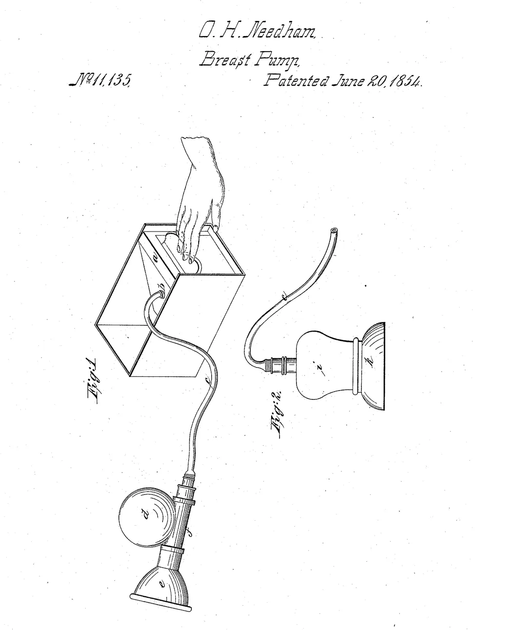
The Needham hand operated pump
Notes:
In 1854, a certain O H Needham applied for a patent for a hand-operated milk pump. I don’t think it took off at the time.

Slide 37
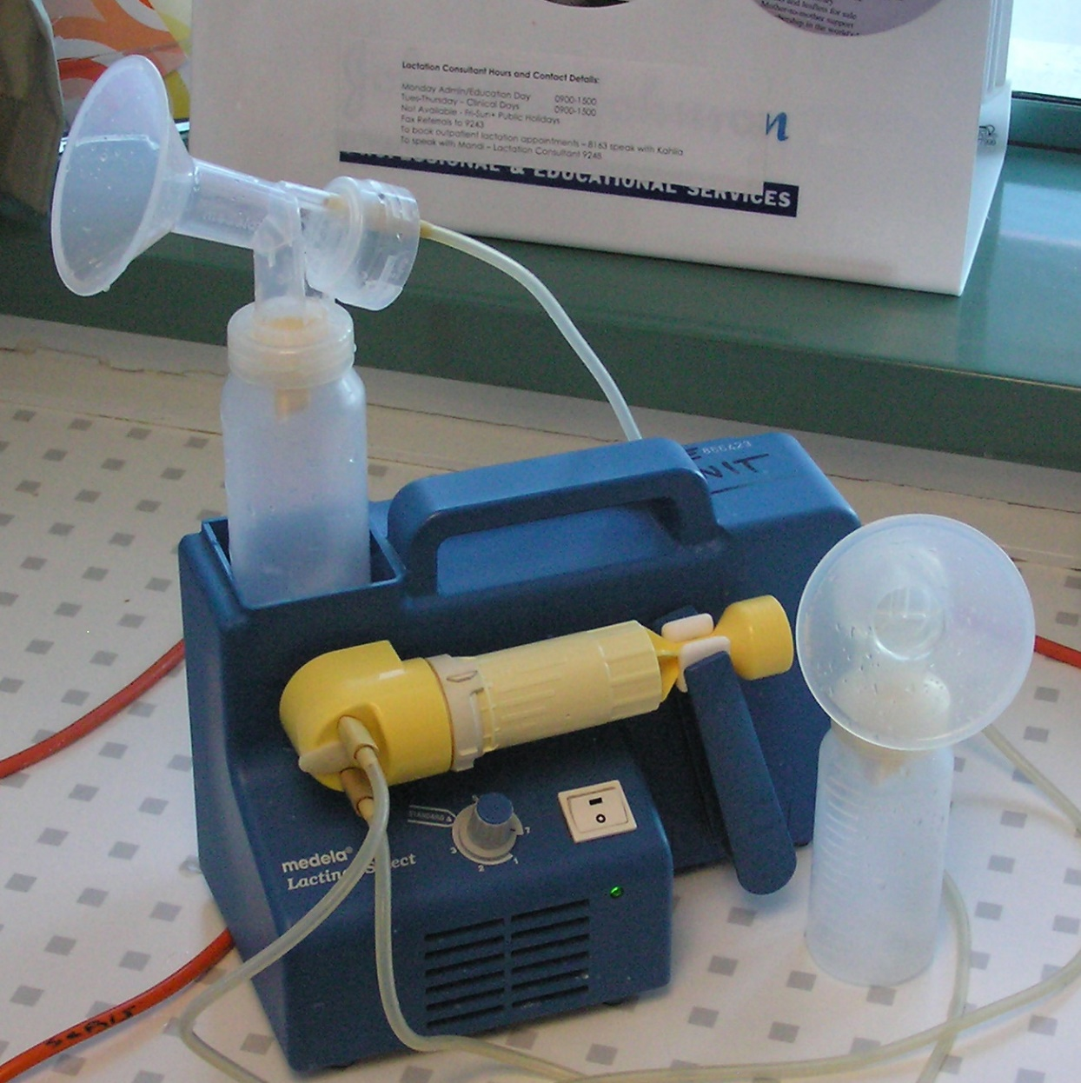
One of the first electric breast pumps used in Hutt Hospital
Notes:
The new wonder, electricity, could be harnessed to work the pumps.
My experience in the 1970/early 80s was that woman found them too much like the previous slide and refused to use them. Most managed to get enough milk to provide for their premature or sick newborns using a Japanese produced hand pump that worked like a large syringe.

Slide 38
Modern Australian pump
Notes:
Cow milking

Slide 39
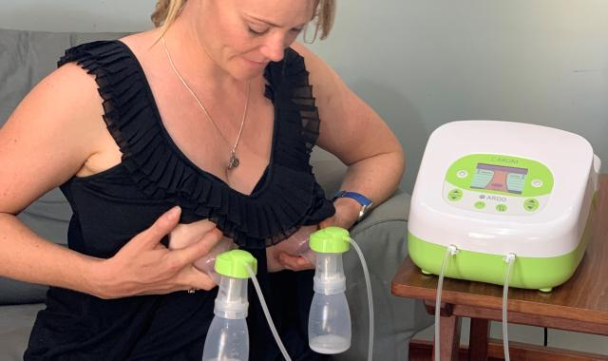
Modern Australian pump
Notes:
Modern Australian model

Slide 40
Human Milk Banking
Only after refrigeration became available
Concern about infection – heat treated, pasteurised
Concern about donor’s medication
Formal Milk Banks screen donors and process the milk reliably
In NZ, mainly for Prems (<1500 gms) in NICU
Notes:
Human milk banking – only possible with the introduction of widespread refrigeration.
Concerns regarding infection need to be dealt with. Pasteurisation is OK for bacteria but do kill neutrophils and probiotic bacteria as well as significantly reduce lactoferrin and immunoglobulins – less so for vitamins. Viruses need to be screened out at source.
Drugs, both official and unofficial, can cause trouble but less likely to be a problem with pooling which dilutes any effect.
Formal banks have rigid protocols for screening donors and handling the milk.
In NZ, places like the wellington and Christchurch NICU have banks especially for prems under 1500 gm and may fortify the basic milk to improve the infant’s growth.

Slide 41
Human Milk Banking
Only after refrigeration became available
Concern about infection – heat treated, pasteurised
Concern about donor’s medication
Formal Milk Banks screen donors and process the milk reliably
In NZ, mainly for Prems (<1500 gms) in NICU
Private sales on the Internet are common, but suspect.
Plus some weirdos are buying it for use in their tea and worse!
Notes:
A story from the Guardian about a woman getting too much breast milk because she was overanxious about having enough. Initially was able to give it to the local hospital neonatal unit, but with increasing concerns about potential infections, privacy and goodness knows what else, she had to stop. Then looked at ways of disposing of it and found women were selling it online (sometimes even to men who ‘liked it in their tea’ and other kinky thoughts)…..

Slide 42
Future
Milk from plants already with us – 1 litre of soy milk requires 1 square mile of land! Also oats, almonds, rice, coconut, etc
Synthetic Cow’s milk produced genetically in the laboratory - 98% of the proteins, need to add immunoglobulins, fats, carbohydrates and minerals
Milk from Cockroaches – superfood!
Milk with plastic – a not-so-good feature!
Notes:
Clearly, not every mother can (or wants) to breast feed and alternatives are safer and closer to the human composition.
Animal milk may remain the basic, but the usually options are becoming more available with formulae based on soy, oats, coconut, almonds, and no doubt more. Like cows, all of these have their challenges in relation to the environment and other alternatives will be sought.
One possibility is that cow milk will be synthesised in future. Presumably, that means that human milk could go down the same path of being synthesised. Although the current , so-called genetic milk only produces the protein which sounds a bit like the mother from long ago with the milk that was inadequate to feed her baby.
I note that milk made from cockroaches has been postulated for the future as a ‘super food’, whatever that means.
Again, a warning about where we are now. …… Noam van der Hal, a PhD in Environmental Sciences at the University of Haifa demonstrated microplastic particles in different types of cow milk. Is this another inheritance we are leaving for our children’s children?

Slide 43
References
Minchin, M. (2018). 14 Infant Feeding in History: an Outline. In Breastfeeding and Breast Milk – from Biochemistry to Impact, (Ed, Family Larson- Rosenquist Foundation) Georg Thieme Verlag KG. The Global Health Network. https://doi.org/10.21429/3d48c34a.94932335
A History of Infant Feeding, Emily E Stevens, RN, FNP, WHNP, PhD, Thelma E Patrick, RN, PhD, and Rita Pickler, RN, PNP, PhD J Perinat Educ 2009 Spring; 18(2): 32–39.
A story of infant feeding, Part IV – 19th Century, by Ian Wickes, Arch Dis Child, 1953;28;141
Guttus, tiralatte and téterelle: a history of breast pumps, Michael Obladen, J Perinatal Med, 2012 Nov;40(6);669
The history of infant nutrition Silvia Diez Castilho,1 Antônio de Azevedo Barros Filho; J Pediatr (Rio J). 2010;86(3):179-188
Erik Olsen, Truby King and the Plunket Society AN ANALYSIS OF A PRESCRIPTIVE IDEOLOGY :University o Otago,
James Watt, Practical Paediatrics : A Guide for Nurses by James Watt, N M Peryer Ltd, 1961
Melanie Jackson and Esther Leslie, Milk, 2023, Wellcome Institute

